Slide 1
Acid, Base & Buffer Solution Professor Dr. Md. Aslam Hossain Department of Pharmaceutical Chemistry University of Dhaka

Slide 2
Acid and Base: Arrhenius’ Theory
Arrhenius’ definition of an acid is - ‘a substance which yields hydrogen ion (H⁺) in an aqueous medium’; and that of a base is - ‘a substance which yields hydroxyl ions (OH–) in an aqueous medium’.
Arrhenius concept is quite useful and explains the acid-base behaviour to a good extent. However it has certain drawbacks like,
It is limited to only aqueous solutions and require dissociation of the substance. It does not explain the behaviour of acids and bases in non-aqueous media.
It does not explain the acidic behaviour of some substances which do not contain hydrogen. for example, AlCl₃. Similarly it does not explain the basic character of substances like NH₃ and Na₂CO₃ which do not have a hydroxide groups.

Slide 3
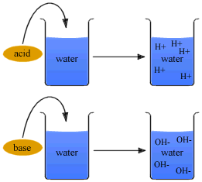
Acids & Bases
An acid is any ionic compound that releases hydrogen _____ (H⁺) in solution.
A base is any ionic compound that releases hydroxide _____ (⁻OH) in solution.
From the Virtual Cell Biology Classroom on ScienceProfOnline.com
Notes:
cations
anions

Slide 4
Acid and Base: Lowry and BrÖnsted’s Theory
In 1923, Brønsted and Lowry pointed out independently that acid-base reactions can be interpreted as proton-transfer reactions. The definition is sufficiently broad and removes the first limitation of Arrhenius concept.
According to Brønsted-theory an acid is a substance that can donate a proton whereas a base is a substance that can accept a proton.
Any hydrogen-containing molecule or ion capable of donating or transferring a proton is an acid, while any molecule or ion that can accept a proton is a base.
For example, in a reaction between ammonia (NH₃) and hydrogen fluoride (HF); ammonia acts as a base (accepts a proton) while HF behaves as an acid (donates a proton).
NH₃ + HF  NH₄⁺ + F⁻

Slide 5
Acid and Base: Lewis’s Theory
Lewis (1923) put forward another definition of acids and bases solely dependent on giving or taking of an electron pair.
According to the theory, ‘an acid is an electron pair acceptor, whereas a base is an electron pair donor’. Therefore, it is obvious that whenever any neutralization occurs, the formation of an altogether new coordinate covalent bond between the electron pair donor and acceptor atoms take place.
Thus, Lewis’s definition is a much broader definition that includes coordination compound formation as acid-base reactions, besides Arrhenius and Lowry-Bronsted acids and bases.

Slide 6
Examples:
The reaction of borontrifluoride (acid) with ammonia (base) results into a stable octet configuration between mutual sharing of a pair of electrons of latter (donor) and former (acceptor).
The reaction of ammonia (base) with Ag⁺ (acid) results into a stable configuration due to the mutual sharing of a pair of electrons of latter (donor) and former (acceptor).

Slide 7
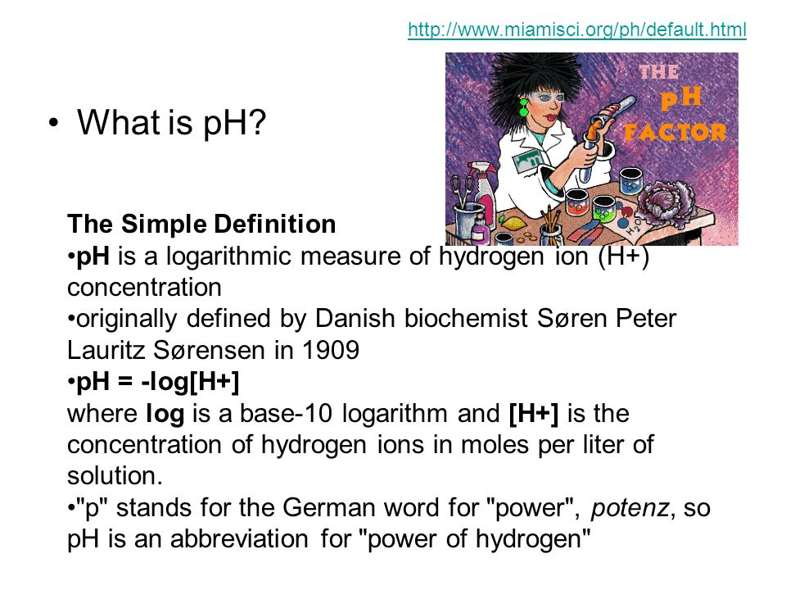

Slide 8
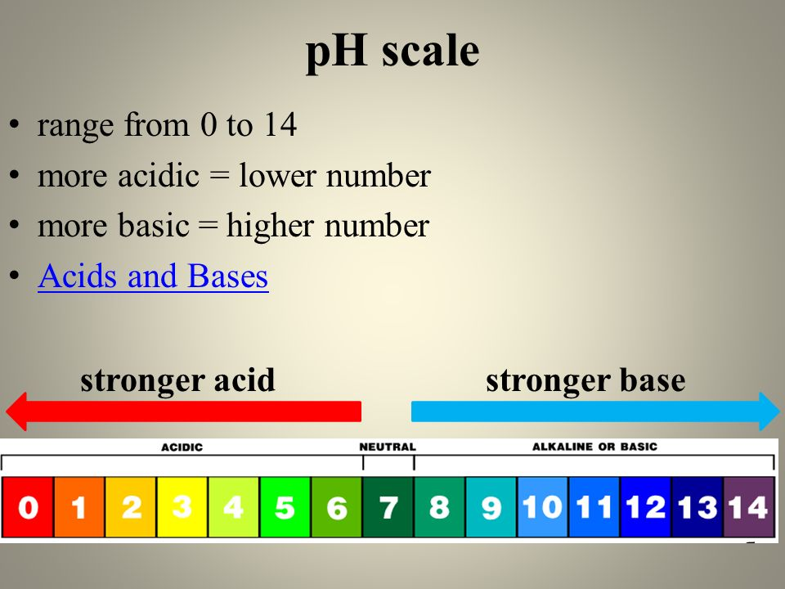

Slide 9
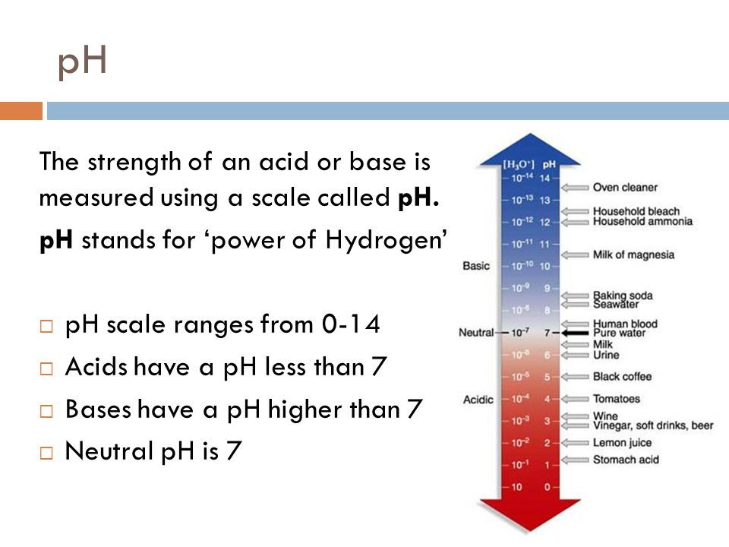

Slide 10
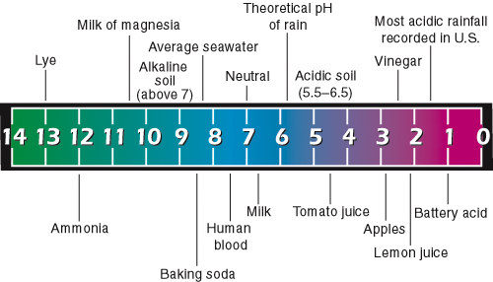
K_{w} = [H₃O⁺][OH⁻] = [H⁺][OH⁻] = 10⁻¹⁴
 - log([H⁺][OH⁻]) = -log(10⁻¹⁴)
 - log[H⁺] - log[OH⁻] = 14
 pH + pOH = 14
For an acid solution [H⁺] > 10^{–7}.
For a basic solution [H⁺] < 10^{–7}.

Slide 11
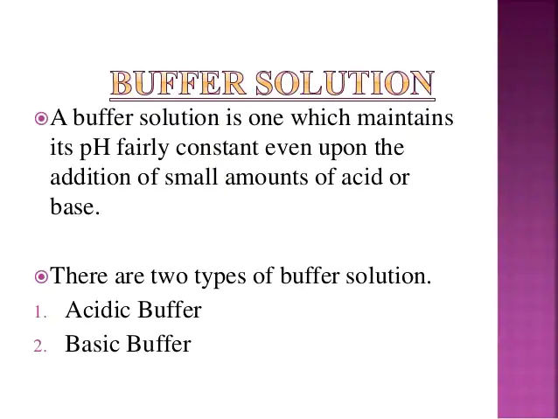

Slide 12
Buffer Solution
A buffer is a solution that contains both a weak acid and its conjugate base, or a weak base and its conjugate acid.
If 1 ml of 0.1 N HCl solution is added to 100 ml of pure water, the pH is reduced from 7 to 3. If the strong acid solution is added to 0.01M solution containing equal quantities of acetic acid and sodium acetate, the pH is changed only 0.09 pH units.
CH₃COOH/ CH₃COONa buffer, NH₄OH/ NH₄Cl buffer etc.

Slide 13
Mechanism of Buffer Action
Adding an Acid to a Buffer
Adding an acid to a buffer (ex. CH₃COOH/NaCH₃COO), the acetate ions from the CH₃COONa react with the added H₃O⁺
CH₃COO⁻ + H₃O⁺  CH₃COOH + H₂O
Added acid causes shift to the right to get rid of H₃O⁺
In this case the added H₃O⁺ are removed and pH is lowered slightly
Adding a Base to a Buffer
Adding a base to a buffer (ex. CH₃COOH/NaCH₃COO), the acetic acid reacts with the added OH⁻
CH₃COOH + OH⁻  CH₃COO⁻ + H₂O
Added base causes shift to the right to get rid of OH⁻
In this case the added OH⁻ reduces amount of acetic acid present and pH is increased slightly

Slide 14
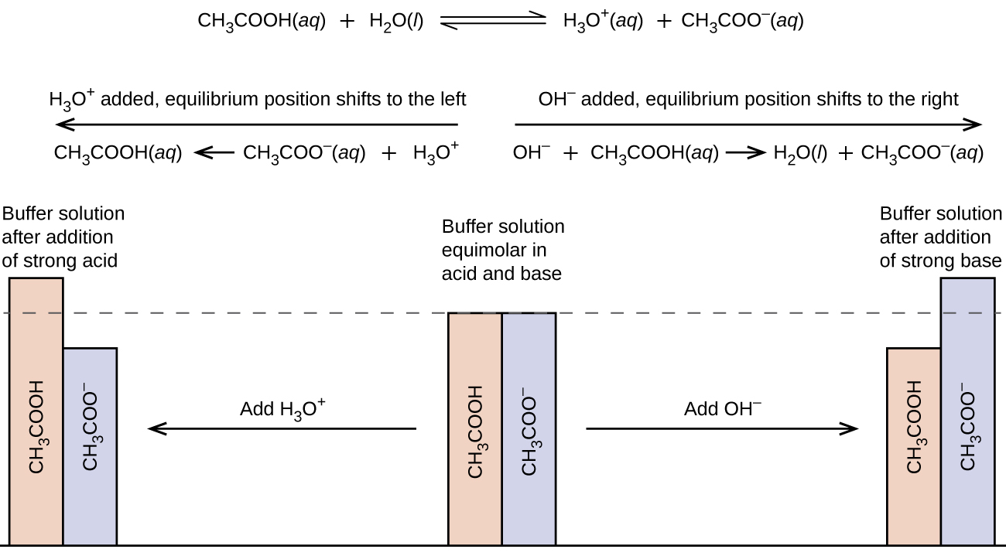
Buffer action mechanism

Slide 15
Buffer in Biological System
Our body is operated under strict conditions of temperature, concentration, and pH.
How do our bodies maintain pH in our bloodstream when we consume a variety of foods at different pH’s?
Our bodies contain solutions of weak acids, containing both acids and conjugate bases, to help neutralize incoming acids and bases. A buffer will resist a change in pH if small amounts of an acid or a base are added.
If pH of blood drops below the normal range of 7.35–7.45 a condition called acidosis occurs.
If blood pH becomes elevated, a condition called alkalosis exists.
Acidosis can be caused by changes in breathing or by changes in metabolism, causing acid to build up in the bloodstream. Alkalosis is caused by acid being removed from the bloodstream.

Slide 16
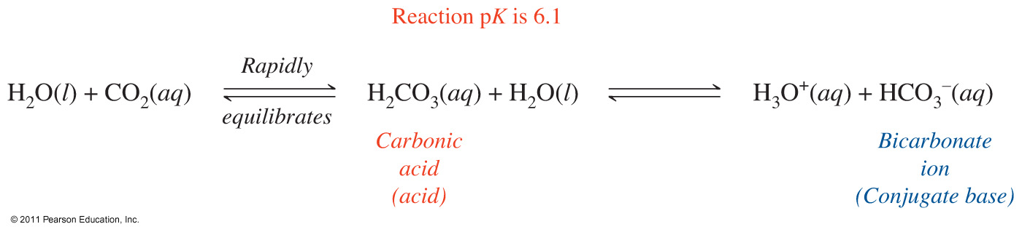
Bicarbonate Buffer
The bicarbonate buffer system is the main buffer system in our blood.
Dissolved CO₂, produced during cellular respiration, is equilibrated through carbonic acid into bicarbonate ions prior to exhalation at the lungs.
The intermediates, carbonic acid and water, are often omitted since they are short lived in the reaction.
The bicarbonate buffer system in our bloodstream is shown as:
The bicarbonate buffer system can be denoted by showing the acid and its conjugate base like this: H₂CO₃/HCO₃⁻. Sometimes the conjugate base is shown as an ionic compound like this: H₂CO₃/NaHCO₃.
Other Buffers:
Acid-alkali sodium salt of phosphoric acid buffer (Phosphate buffer)
Hemoglobin buffer
Plasma proteins (behaves as acid, can combine with base & so acts as buffer)

Slide 17
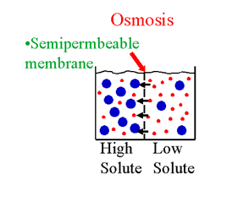
Tonicity
Osmosis is the diffusion of solvent through a semi-permeable membrane.
Water always flows from lower solute concentration [dilute solution] to higher solute concentration until a balance is produced.
Osmotic pressure is the force that is produced by the diffusion of solvent.
Tonicity is a measure of the osmotic pressure of two solutions separated by a semi-permeable membrane.
In other words, tonicity is the relative
concentration of solutes dissolved in
solution which determine the direction
and extent of diffusion.

Slide 18
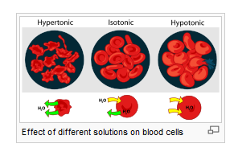
Types of Tonicity
Hypertonic | isotonic | Hypotonic
NaCl 2% | NaCl 0.9% | NaCl 0.2%
solute ‹ solute Inside outside | solute ₌solute Inside outside | solute › solute Inside outside
shrinkage | equilibrium | swelling

Slide 19
Isotonic Solutions-Why?

